Slide 1

SYSTEM AND NETWORK ADMINISTRATION
Presented to Mr. Santosh Panth

Slide 2
PRESENTED BY
BIKASH BARAL(NPI000021)
SHIVAM RANABHAT(NPI000047)
KAPIL POKHREL(NPI000030)

Slide 3
CONTENTS OF THIS TEMPLATE
Our powerpoint presentation includes the following topics
INTRODUCTION
IP TABLES(SHIVAM RANABHAT)
STUNNEL(BIKASH BARAL)
SUDO(KAPIL POKHREL)
GROUP COMPONENTS
CONCLUSION

Slide 4
Words of gratitude!!
We would like to express our gratitude to Infomax College of IT and Management, as well as our teacher, Mr. Santosh Pant, for assisting us in properly planning our assignment.

Slide 5

INTRODUCTION
The objective of this assignment is to make us understand the basics and role of networking and administration services.Networking services are the foundation of a networked computing environment. This assignment helps us to understand the role of a network and system administrator by doing some enhancement and applying them to a simulated network through using a gateway, mailhost, webserver and ldap.

Slide 6
01
INDIVIDUAL COMPONENT

Slide 7
IP tables (Shivam Ranabhat)
Ip tables is a network administrative tool which is used to filtering IPv4 packet and NAT.
The major aim of this enhancement is to apply the six available rules of IP tables in order to filter out the TCP stack and to prevent the network from processing the TCP stack.
Ip tables is used to display all the six rules which is added with hping2 and multi tail

Slide 8
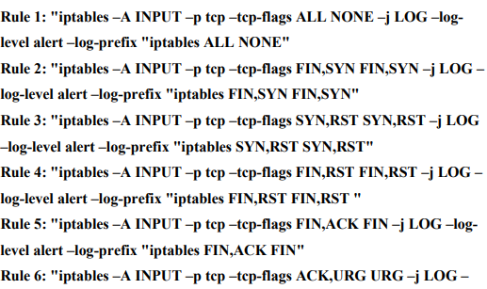
Configuration
we need add the available six rules of IP tables in command line which are shown above:

Slide 9
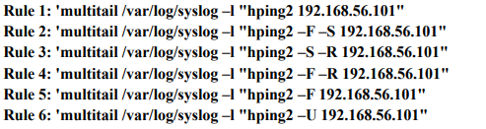
Configuration
We use “iptables-L” in order to see all the IP rules.
According to question, we should display the IP tables using hping 2 and multi tail so we should enter the six commands which are shown below:

Slide 10
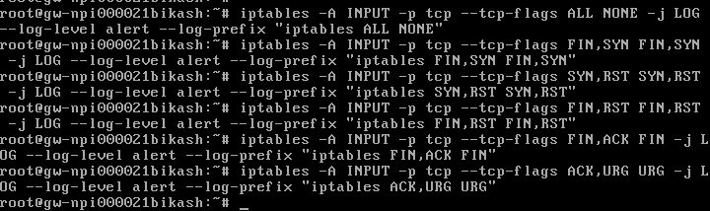
Screenshots
Fig: Six rules of IP Tables
The following rules were directly typed on the command line in gateway

Slide 11
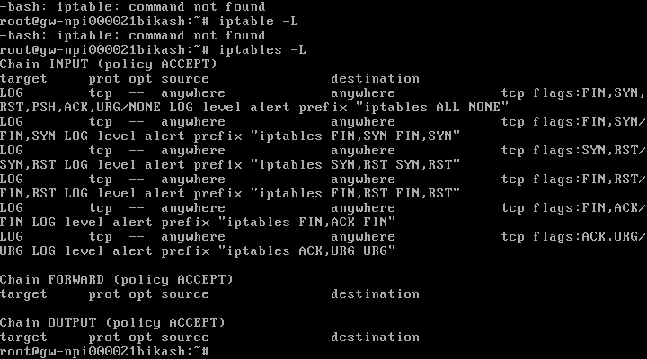
Screenshots
Fig: Newly added rules
This shows all the lists of IP tables rules which we have added.

Slide 12
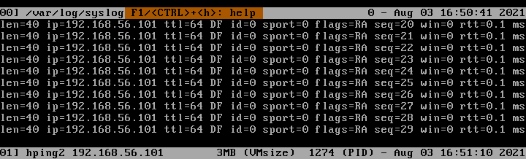
Screenshots of Rules
Fig: Showing Rule 1

Slide 13
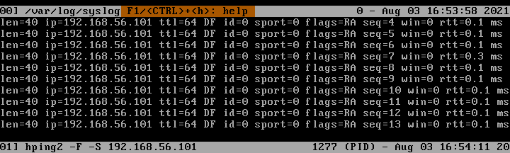
Screenshots of Rules
Fig: Showing Rule 2

Slide 14
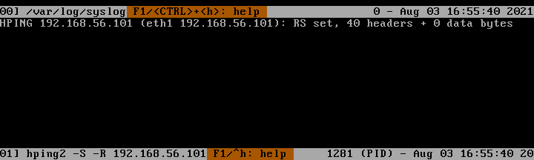
Screenshots of Rules
Fig: Showing Rule 3

Slide 15

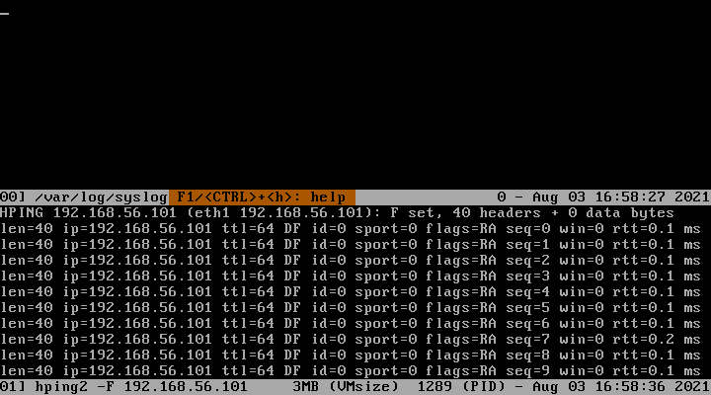
Screenshots of Rules
Fig: Showing Rule 4
Fig:Showing Rule 5

Slide 16
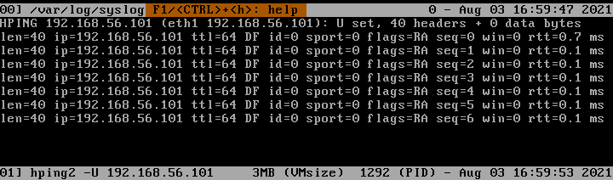
Screenshots of Rules
Fig: Showing Rule 6

Slide 17
Stunnel (Bikash Baral)
Stunnel is a multi-platform and open-source application which provides a global tunneling service for TLS/SSL. It may be used to protect the encrypted connections for both client and server. Similarly, it uses X public key encryption. Stunnel operates by listening to another port and redirecting traffic to unsecured port. Stunnel ensures for error messages and also allows users to connect their domain to send a mail.

Slide 18
Configuration Done
1.Rename /etc/rc.d/rc.xinetd/telnet to /etc/rc.d/inetd and set execute bits.

Slide 19
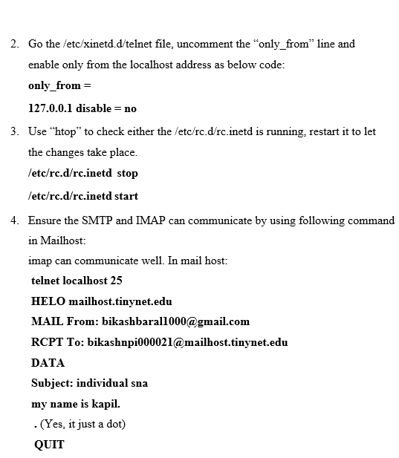

Slide 20
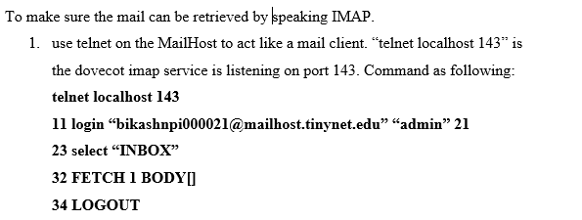

Slide 21
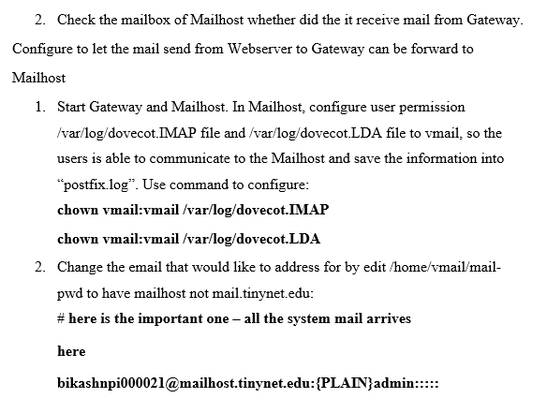

Slide 22
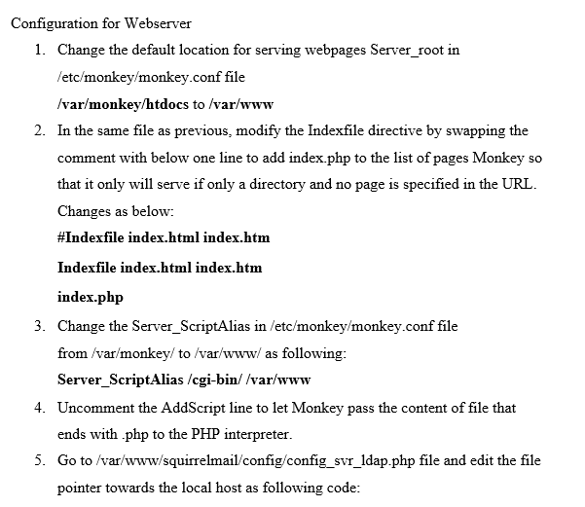

Slide 23
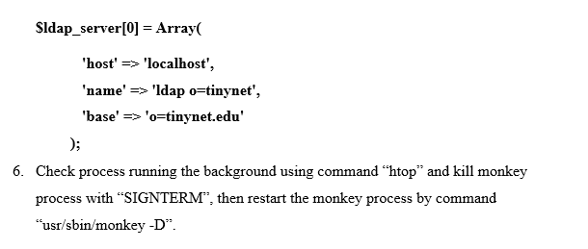

Slide 24
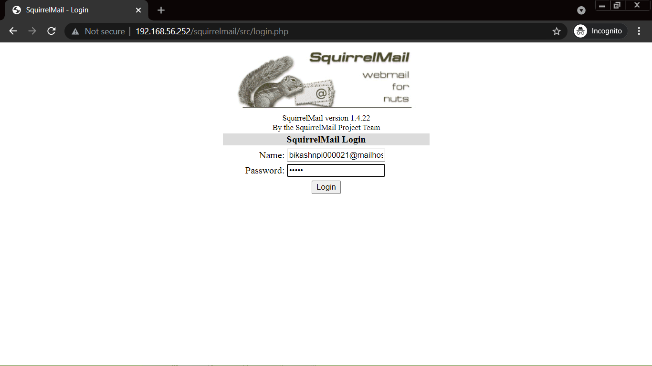
Test with screenshot
Fig: Squirrel mail login

Slide 25
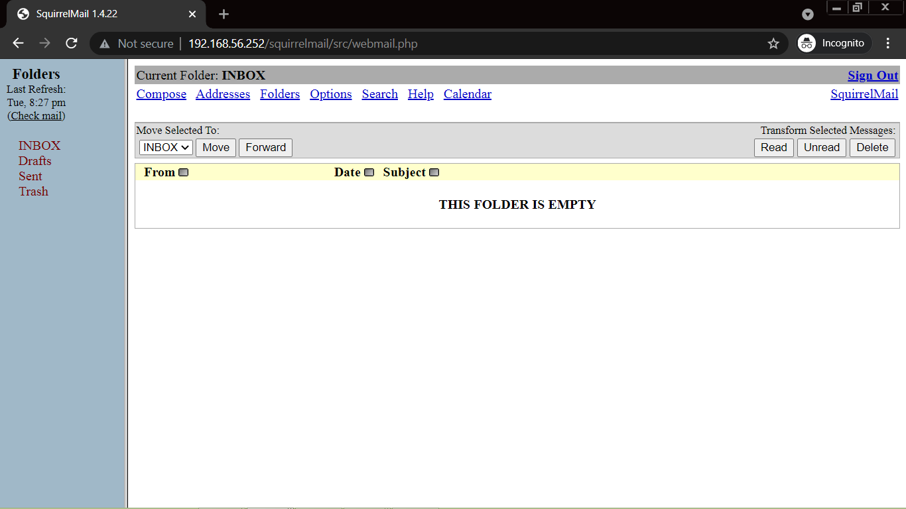
Fig: Empty inbox

Slide 26
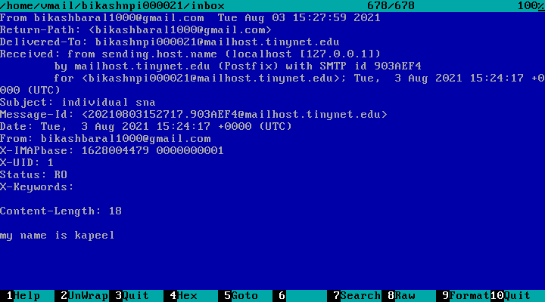
Fig: Message from telnet localhost

Slide 27
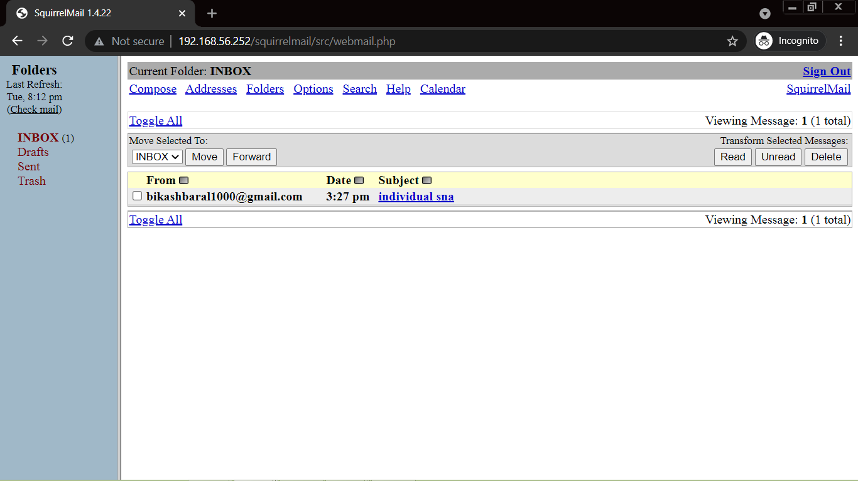
Fig: Message received

Slide 28
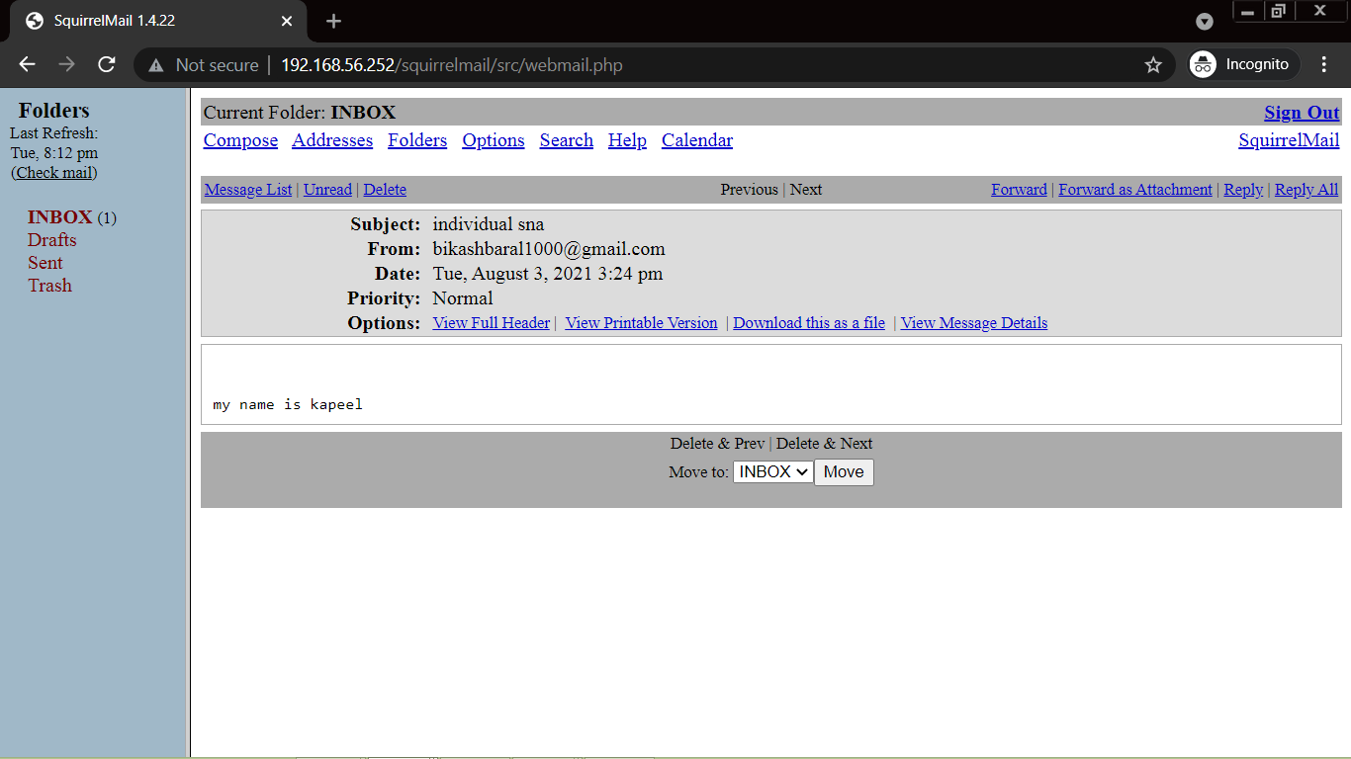
Fig: Details of message received

Slide 29
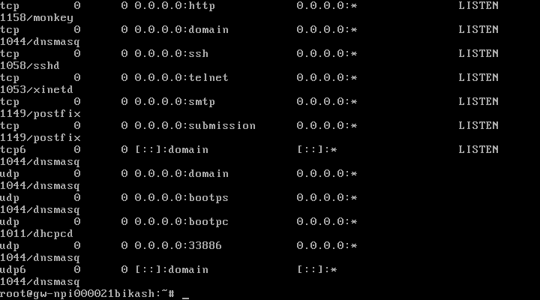
Fig: Gateway listening port

Slide 30
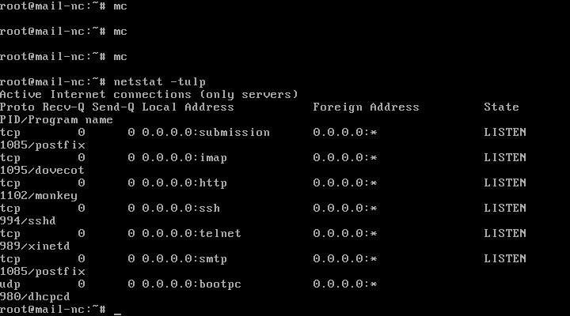
Fig: Mailhost listening port

Slide 31
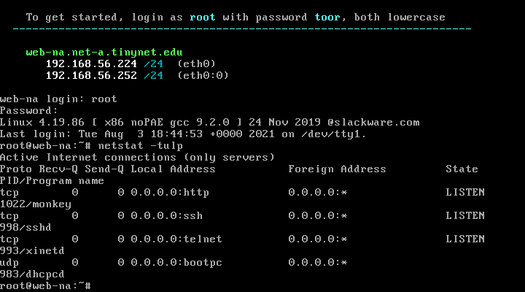
Fig: Webserver listening port

Slide 32
Sudo (Kapil pokhrel)
Depending upon the security policy, sudo allows a permitted user to run a command as superuser or other. The meaning of sudo is task and permission according to the capability of a super user. This feature or software allows normal users to have administrative capabilities in Linux operating systems. SUPERUSER DO (Sudo) is a command that allows a super user to perform tasks and grant permissions.

Slide 33
Configuration Done
Using the command “adduser” on mail host we have created two normal users with following details
“Username: kapil; password: kapil
Username: shivam; password: shivam”

Slide 34
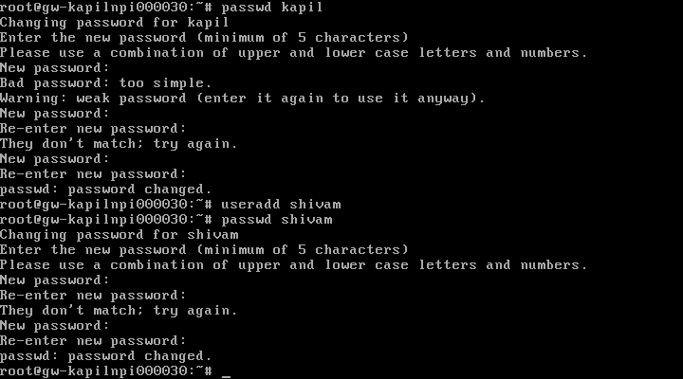

Slide 35
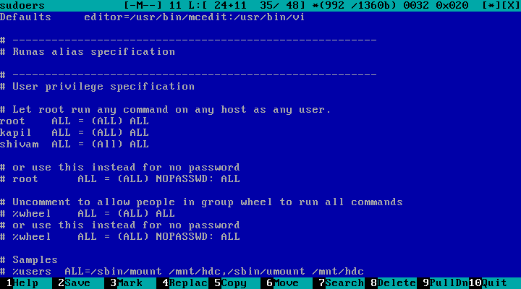
Fig: Force to use sudo

Slide 36
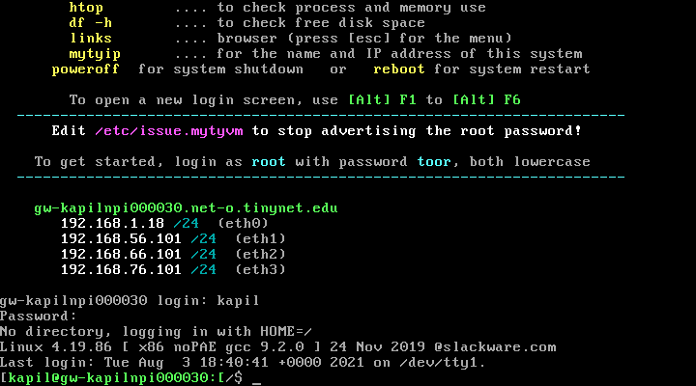
Fig: Color prompt for user kapil

Slide 37
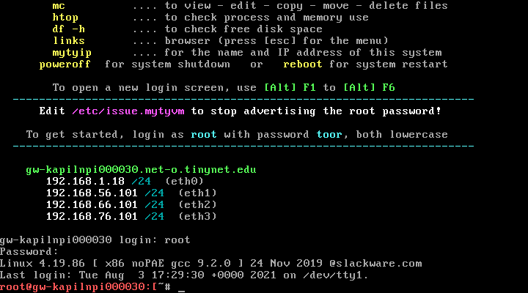
Fig: Color prompt for root

Slide 38
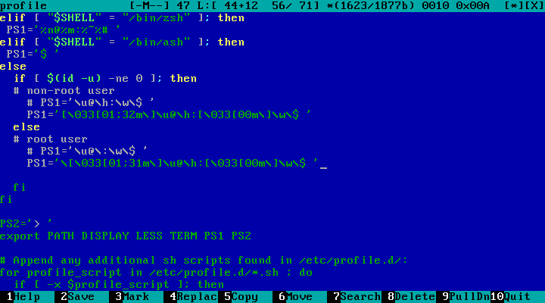
Fig: Editing the profile to display different colors

Slide 39
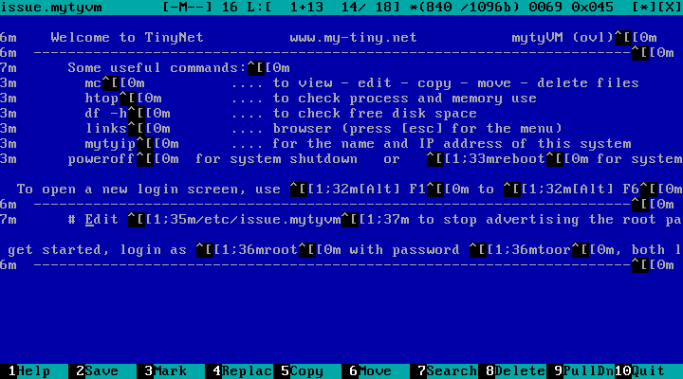
Fig: Stop advertising the root password

Slide 40
References

